Slide 1

A Closer Look at Methods and Classes
Week 6

Slide 2
Agenda
Recap of the Last Lecture
Method Overloading
Constructor Overloading
Using Object as Parameters
  Pass by Value
  Pass by Reference
Returning Objects
Recursion
Introducing the Access Control
Understanding the Static Keyword
Introducing the Final keyword
Inner Classes
The String Class
Recap

Slide 3
Method Overloading
Method with the same name but different in parameter list is called method overloading.
Method overloading is one of the ways that Java supports polymorphism.
Thus, overloaded methods must differ in the data type and/or number of their parameters.
While overloaded methods may have different return types, the return type alone is insufficient to distinguish two versions of a method.
When Java encounters a call to an overloaded method, it simply executes the version of the method whose parameters match the arguments used in the call.

Slide 4
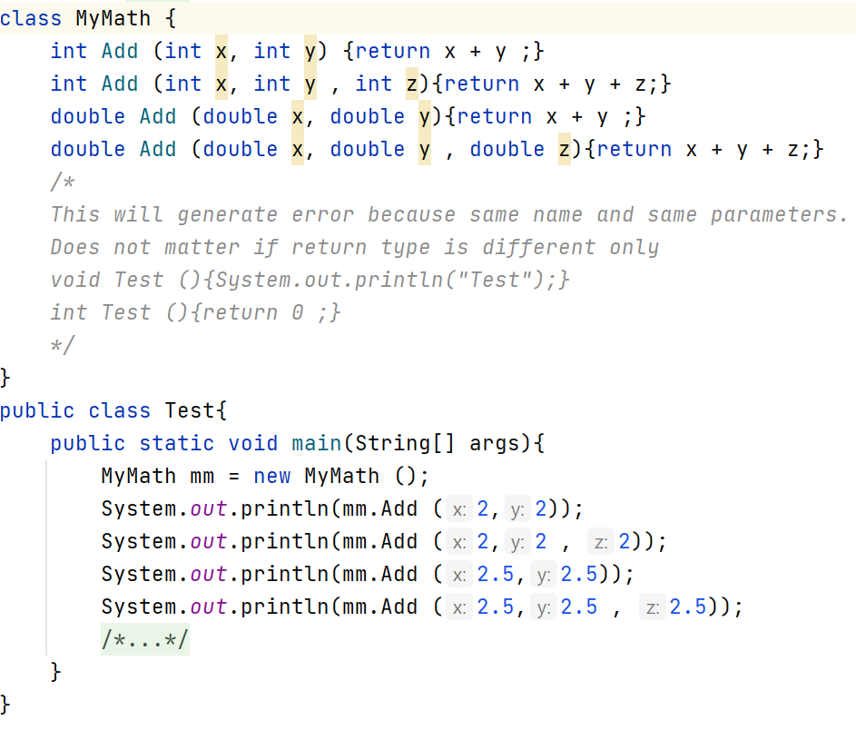

Slide 5
Constructor Overloading
In addition to overloading normal methods, you can also overload constructors.
In fact, for most real-world classes that you create, overloaded constructors will be the norm, not the exception.

Slide 6
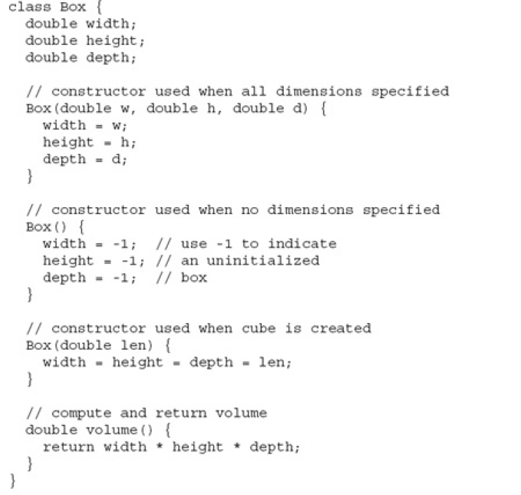

Slide 7
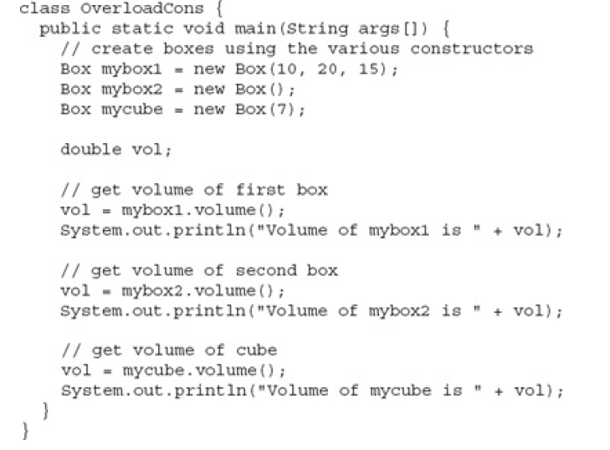

Slide 8
Introducing the Access Control
Encapsulation links data with the code that manipulates it.
However, encapsulation provides another important attribute: access control.
Through encapsulation, you can control what parts of a program can access the members of a class.
By controlling access, you can prevent misuse.

Slide 9
Introducing the Access Control
Java’s access modifiers are public, private, and protected.
Java also defines a default access level.
protected applies only when inheritance is involved.
The other access modifiers are described next.

Slide 10
Introducing the Access Control
Java’s access modifiers are public, private, and protected.
Java also defines a default access level.
protected applies only when inheritance is involved.
Protected and default will be covered during the inheritance and packages topics.

Slide 11
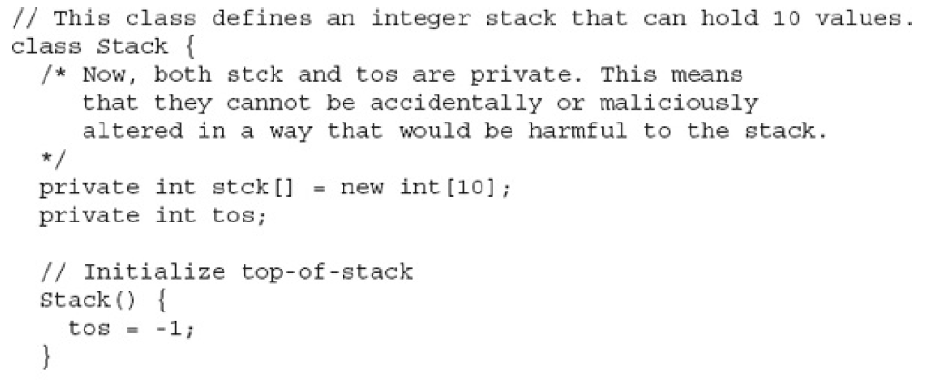

Slide 12
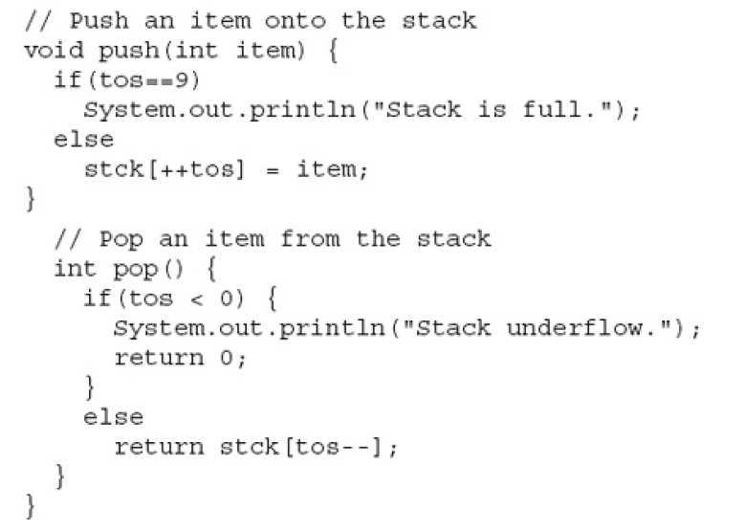

Slide 13
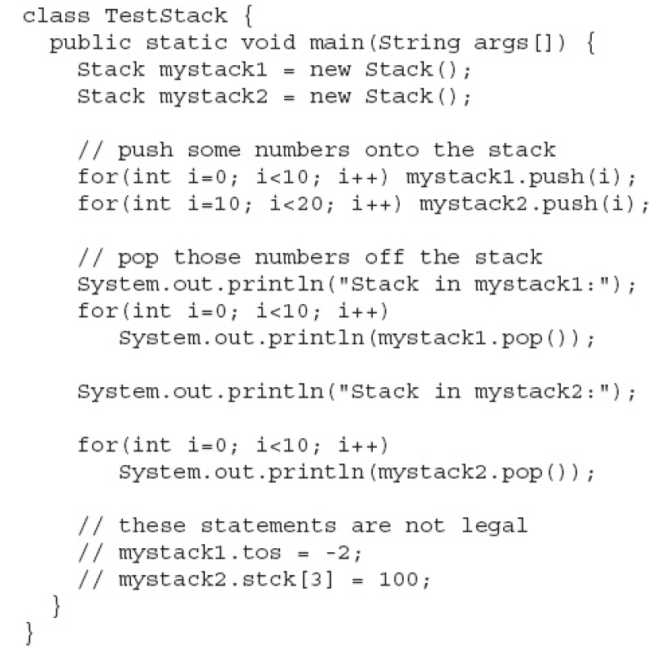

Slide 14
The static keyword
It is used to create a member that can be used by itself, without reference to a specific instance.
The most common example of a static member is main( ). main( ) is declared as static because it must be called before any objects exist.
When
objects of its class are declared; no copy of a static variable is made. Instead, all instances of the class share the same static variable.
Static can be variable as well as methods.
Static methods can only access the static data.

Slide 15
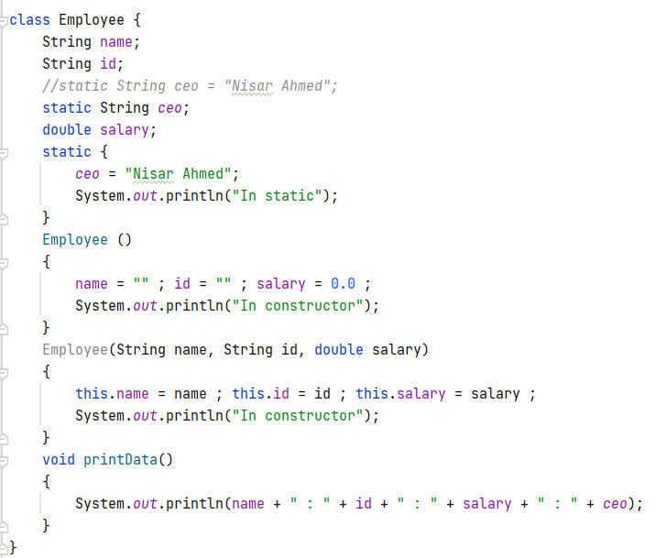

Slide 16
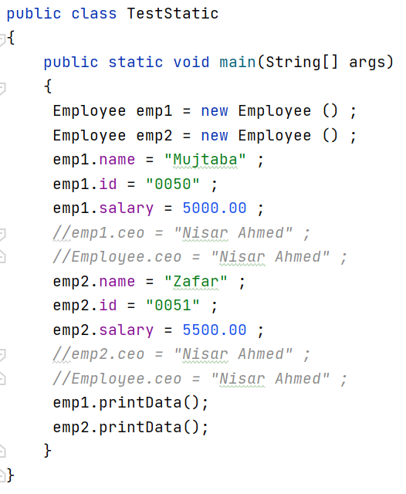

Slide 17
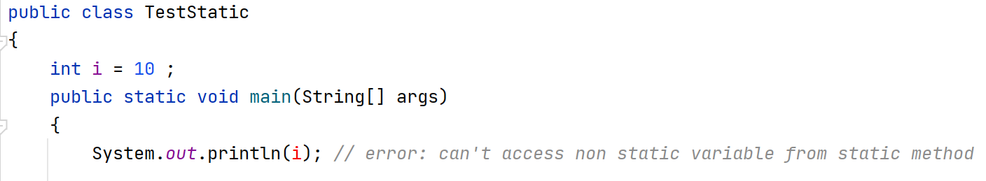
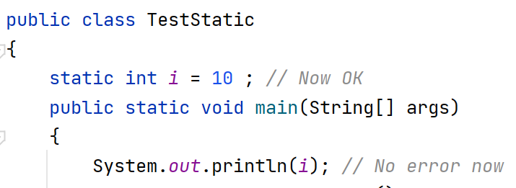

Slide 18
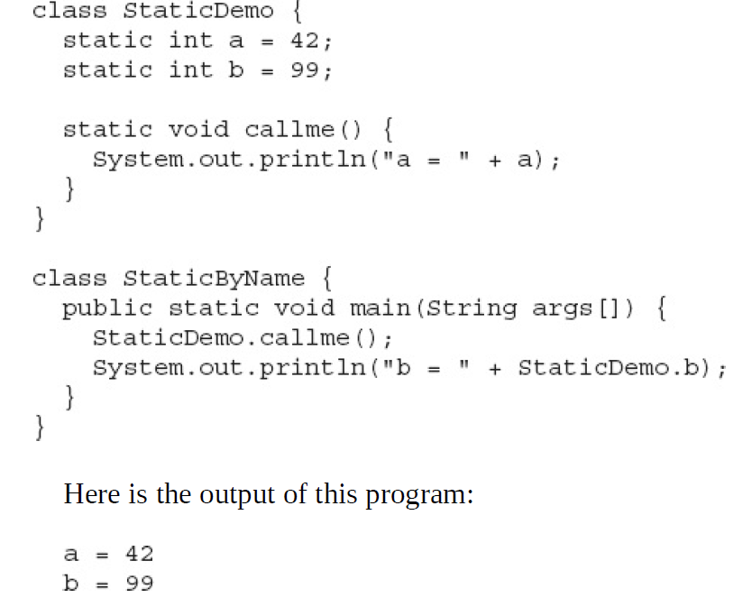

Slide 19
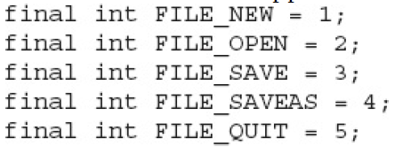
The final keyword
The keyword final serve three main purposes in Java
  It is used to create a constant variable in Java (Applied on Variable).
  It is used to prevent method overriding (Applied on Method)
  It is used to prevent inheritance (Applied on Class).
But here we consider the first point which is using final for creating constant variables.
The second and third uses will be discussed in chapter 8 (Inheritance).

Slide 20
Using Objects as Parameters
So far, we have only been using simple types as parameters to methods.
However, it is both correct and common to pass objects to methods.

Slide 21
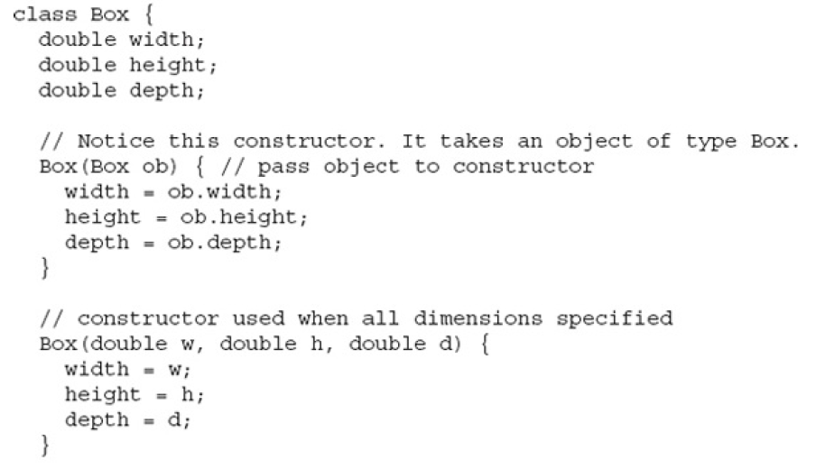

Slide 22
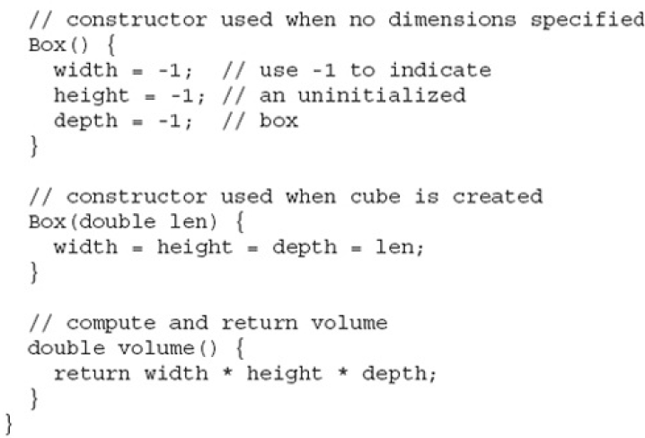

Slide 23
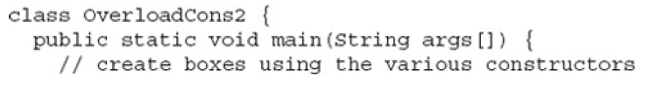
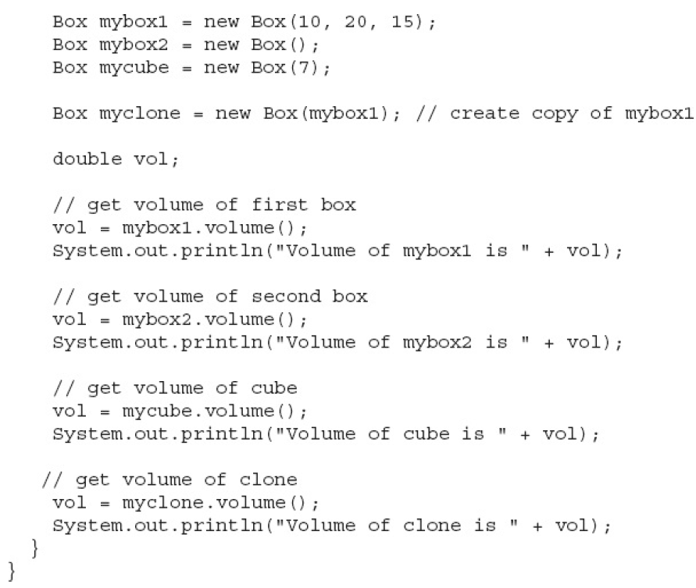

Slide 24
Pass by Value and Pass by Reference
The pass by value copies the value of an argument into the formal parameter of the subroutine. Therefore, changes made to the parameter of the subroutine have no effect on the argument.
In pass by reference, a reference to an argument (not the value of the argument) is passed to the parameter. Inside the subroutine, this reference is used to access the actual argument specified in the call. This means that changes made to the parameter will affect the argument used to call the subroutine.
The precise effect differs between whether a primitive type or a reference type is passed.

Slide 25
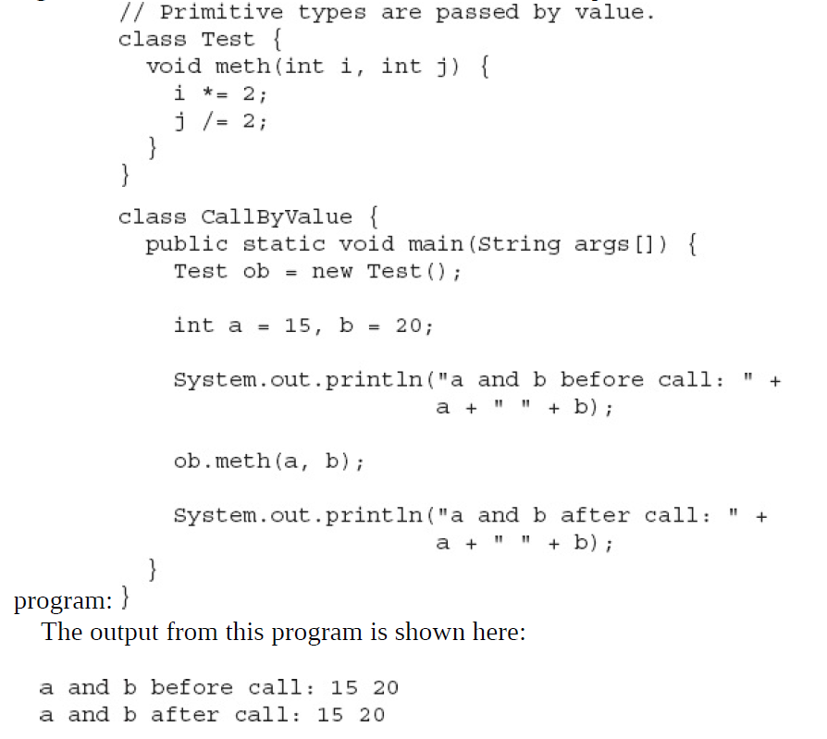

Slide 26
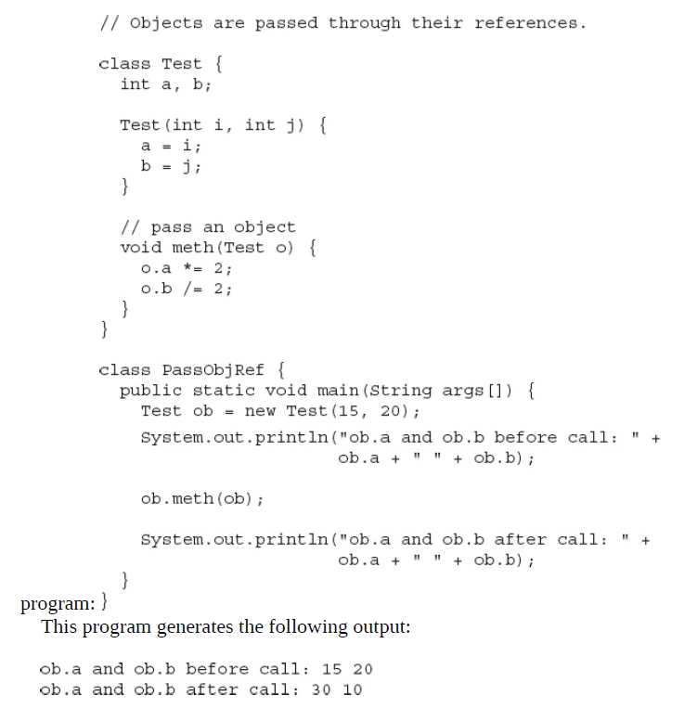

Slide 27
Returning Objects
A method can return any type of data, including class types that you create.
For example, in the following program, the incrByTen( ) method returns an object in which the value of a is ten greater than it is in the invoking object.

Slide 28
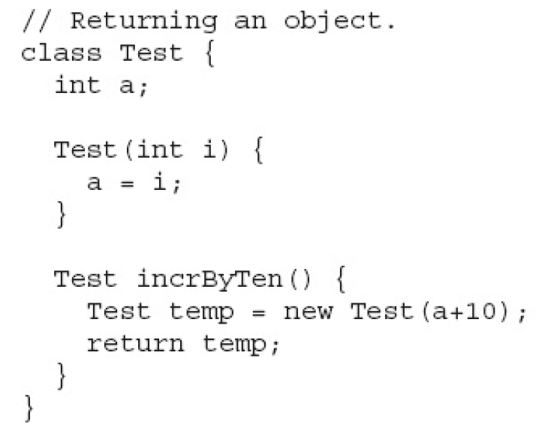

Slide 29
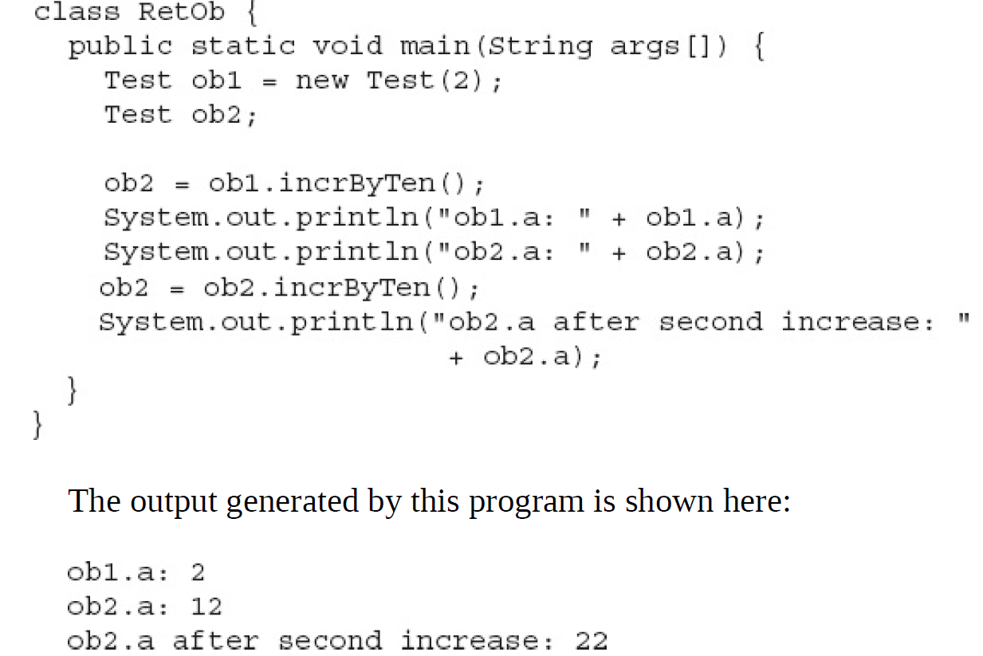

Slide 30
Recursion
Recursion is the process of defining something in terms of itself.
Recursion is the attribute that allows a method to call itself.
A method that calls itself is said to be recursive.

Slide 31
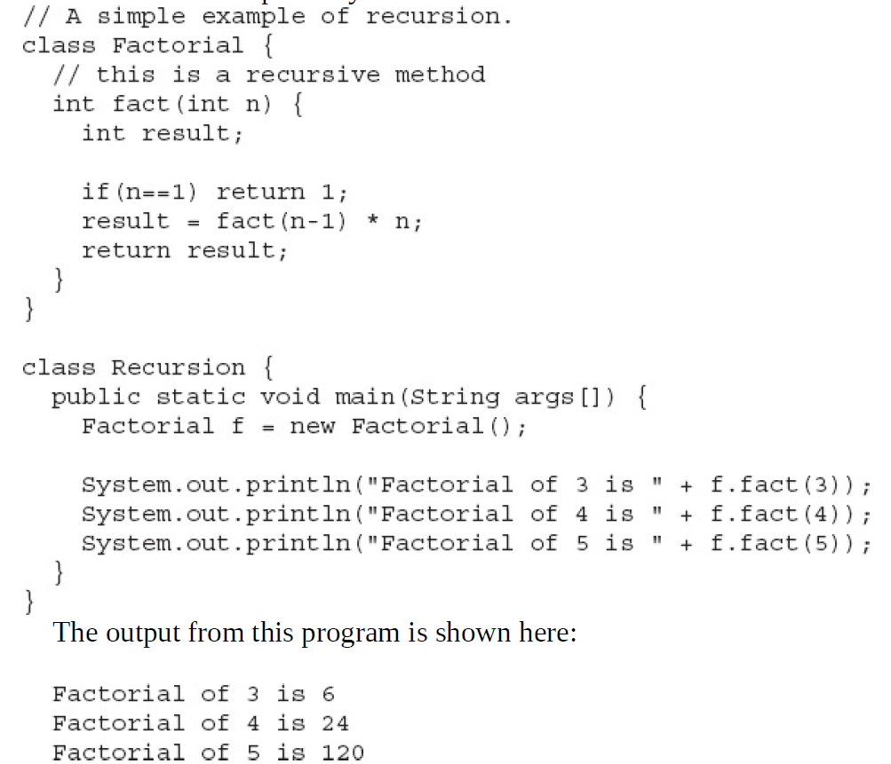
https://dichchankinh.com/~galles/visualization/RecFact.html

Slide 32
Recap
Method Overloading
Constructor Overloading
Using Object as Parameters
  Pass by Value
  Pass by Reference
Returning Objects
Recursion
Introducing the Access Control
Understanding the Static Keyword
Introducing the Final keyword
Inner Classes
The String Class

